Slide 1
Managing Decision Making and Problem Solving
Chapter 7
Miami Dade College
Sep 28th, 2019

Slide 2
Decision making defined
The act of choosing one alternative from among a set of alternatives
Identifying the set of feasible alternatives before selecting one
Decision making process:
Recognizing the nature of a decision situation
Identifying alternatives
Choosing the best alternative (effectiveness)
Putting it into practice

Slide 3
Continued…
Effective decision:
Optimizing some set of factors, profits, sales, market share…
Minimizing loss, expenses, employee turnover

Slide 4
Types of decisions
Programmed decision:
One that is relatively structured or recurs with some frequency
Purchasing new supplies, sponsoring an sport team, …
2. Non-programmed decision:
Relatively unstructured and occurs much less often
Intuition and experience are major factors
Mergers, acquisitions, new facilities, legal issues…

Slide 5
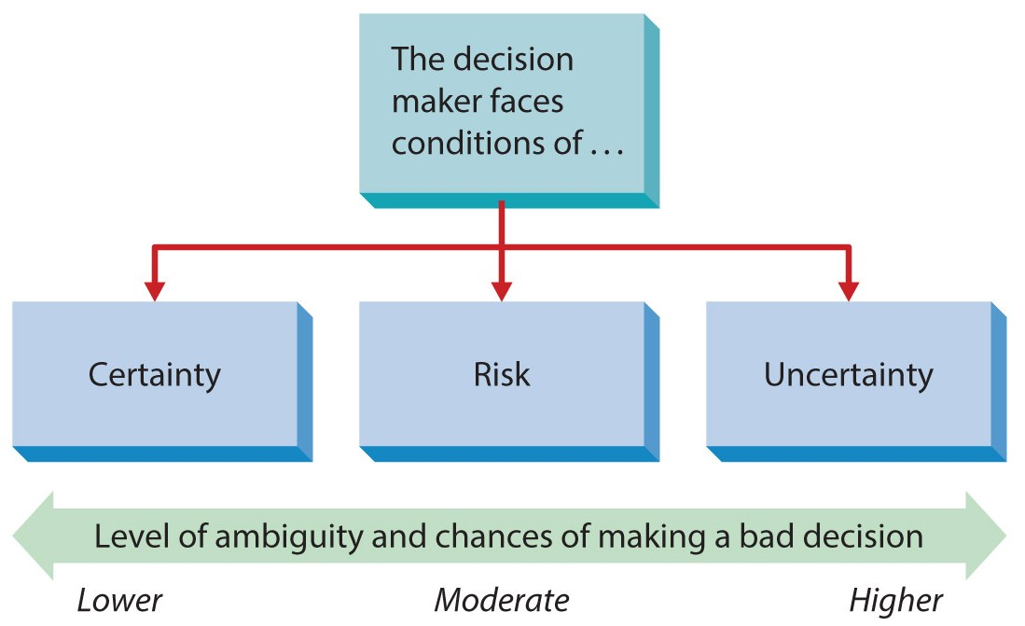
Decision-making conditions
Most major decisions in organizations today are made under a state of uncertainty

Slide 6
Continued…
Decision making under certainty:
Decision makers know with reasonable certainty what the alternatives are
What conditions are associated with each alternative
Little ambiguity and relatively little chance of making a bad decision
The complexity and turbulence of the business make true certainty rare
2. Decision making under risk:
The availability of each alternative and its potential payoffs and costs are associated with probability estimates
Alternatives of accepting or rejecting an offer
Moderate ambiguity and chances of a bad decision

Slide 7
Continued…
3. Decision making under uncertainty:
The decision makers don’t know all the alternatives and the risk associated with each
They don’t know the likely consequences of each alternative
This uncertainty stems from the complexity and dynamism of organizations and their environments
Managers must acquire as much relevant information as possible
Managers should use logical and rational perspective
Intuition, judgment and experience play major roles
Moral, ethical and legal responsibilities
The most ambiguous condition and the most prone to error

Slide 8
Rational perspectives on decision making
It is based on the classical model
Assumptions:
Managers are logical and rational
They make decisions that are in the best interests of the organization
Classical model view:
Obtaining complete information about the decision situation and possible alternatives
Eliminating uncertainty and focusing on facts and logic
Evaluating all aspects of the decision situation logically and rationally

Slide 9
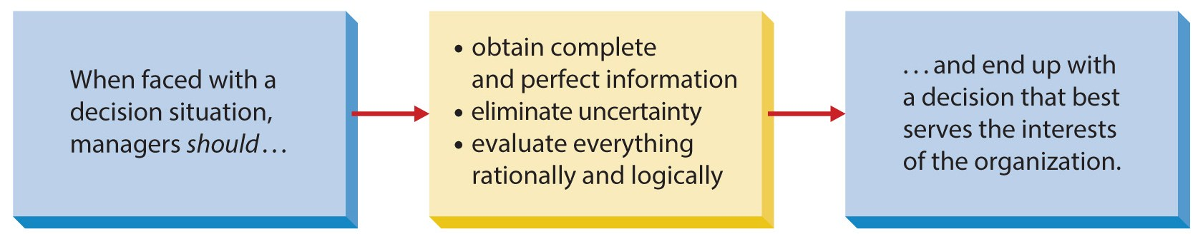
Continued…
These conditions rarely, if ever, actually exist.

Slide 10
Steps in rational decision making
Recognizing and defining the decision situation:
Recognizing that a decision is necessary based on some stimulus
Defining precisely what the problem is
Careful analysis and consideration of the situation
2. Identifying alternatives:
Developing standard alternatives and innovative solutions
Both obvious and creative alternatives are required
Some constraints limit the alternatives: legal constraints, moral and ethical norms, authority constraints,…

Slide 11
Continued…
3. Evaluating alternatives:
Each alternative should be evaluated in terms of feasibility, satisfactoriness, consequences,…
Feasible: is an alternative practical?
Limited human, material and information sources may make other alternatives impractical
Satisfactoriness: how well it satisfies the conditions of the decision situation?
Consequences: to what extent will an alternative influence other parts of the organization?
If the consequences are too expensive for the organization, the alternative should be eliminated

Slide 12
Continued…
4. Selecting an alternative:
The optimal combination of feasibility, satisfactoriness, and affordable consequences
So, multiple acceptable alternatives may be possible
Managers can often develop subjective estimates and weights for choosing an alternatives

Slide 13
Continued…
5. Implementing the chosen alternative:
Managers should consider people’s resistance to change when implementing decisions
The reasons can be: insecurity, inconvenience, and fear of unknown factors
For instance: resigning rather than relocating
6. Following up and evaluating the results:
Managers should evaluate the effectiveness of their decision
If it has not served as expected, another identified alternative should be adopted

Slide 14
Behavioral aspects of decision making
Decisions are made with little consideration for logic and rationality
Decisions are affected by inherent biases and limitations
This aspect relies on the administrative model

Slide 15
Administrative model
1. Using incomplete and imperfect information
2. Managers are constrained by bounded rationality:
Managers are limited by their values and unconscious reflexes, skills and habits
They are limited by less than complete information and knowledge
3. Managers tend to satisfice:
Searching until they identify an alternative that meets some minimum standard of sufficiency (not the best possible one)

Slide 16
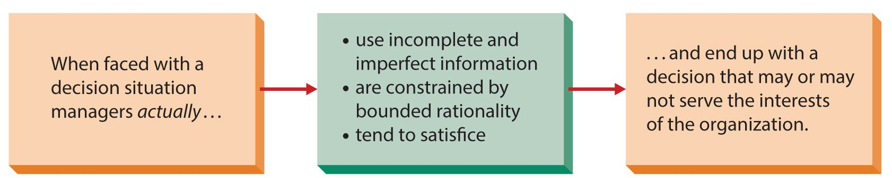
Administrative Model

Slide 17
Other behavioral aspects
Political forces:
Coalition: informal alliance of individuals or groups
It is formed to achieve a common goal
Coalitions of stockholders to force a BOD to make a certain decision
It can be either positive or negative
2. Intuition:
Inner belief about something without conscious consideration
This feeling is based on years of experience and practice
Occasional decision without going through rational steps
3. Escalation of commitment:
A decision maker’s staying with a decision even when it appears to be wrong
Staying with decisions even in the face of increasing losses

Slide 18
Continued…
4. Risk propensity
A decision maker is willing to gamble when making a decision
Some managers are cautious and conservative
Other managers are aggressive in decision making and are willing to take risks
They rely on intuition and make decisions quickly
They are more likely to achieve big successes and also greater losses
5. Ethics:
Individual ethics: personal beliefs about right and wrong behavior
Closing a company will lead to the loss of several jobs

Slide 19
Group and team decision making
Interacting groups and teams:
Most common form of decision-making group
Departments, regular work teams,…
Team members talk, argue, and agree among themselves
Interaction sparks new ideas and promotes understanding
2. Delphi groups:
A group is used to achieve a consensus of expert opinion
The opinions of a panel of experts are combined and averaged
Group members don not see on another
Experts: research scientists, university researchers, …

Slide 20
Continued…
3. Nominal groups:
Members are brought together in a face-to-face setting
It is used most often to generate creative and innovative alternatives
Experts are asked to write down as many alternatives as they can think of
Members rank the various alternatives
The highest-ranking alternative represents the decision of the group

Slide 21
Advantage and disadvantages of team decision making
Advantages:
More information, knowledge and alternatives are available
More acceptance of the final decision is likely
Better decisions generally emerge
Disadvantages:
The process takes longer and it is costlier
One person may dominate the group
Groupthink: the desire for consensus overwhelms the best possible decision. Avoiding conflict among members

